Slide 1
Spark Architecture and Runtime Environment
Week-5
Explore how Spark processes the requests that your application submits. Learn how you can track work using the Spark Application UI. Because Spark application work happens on the cluster, you need be able to identify Apache Cluster Managers, their components, benefits, and know how to connect with each cluster manager and how and when you might want to set up a local, standalone Spark instance. Next, learn about Apache Spark application submission, including use of Spark’s unified interface, ‘spark-submit’ and learn about options and dependencies. Developers now have the option of AIOps. Discover how to use Spark within AIOps and with Apache Spark application submission, including use of Spark’s unified interface, ‘spark-submit’, describe and apply options for submitting applications, identify external application dependency management techniques and list Spark Shell benefits. View and see recommended practices for Spark's static and dynamic configuration options. Round out your development knowledge with insights about Spark on Kubernetes. This module features hands-on Spark labs using IBM Cloud and Kubernetes.
Learning Objectives
Describe Apache Spark architecture and explain Spark Application processes including Jobs, Tasks, Stages, and cluster deploy modes.
Discuss Apache Spark cluster modes, including their components and benefits.
Explain how to connect to each Apache Spark cluster mode and how and when to setup a local, standalone Spark instance.
Describe Apache Spark application submission, including use of Spark’s unified interface, ‘spark-submit.’
Describe and apply options for submitting Apache Spark applications, identify external application dependency management techniques. list Spark Shell benefits.
Create a Python script that contains an Apache Spark job and submit the Apache Spark job to a cluster.
List the benefits of using Apache Spark with IBM Cloud and define AIOps.
Describe how to use Spark within AIOps and with IBM Spectrum Conductor, IBM Watson, and the IBM Analytics Engine.
Create a Jupyter Notebook on Watson Studio that has a Python kernel with Apache Spark installed.
Describe Apache Spark application configuration types, purposes, common options, and describe when to use static or dynamic configurations.
Describe when and why to use Kubernetes, how to run Kubernetes locally or on the cloud, and how to run Apache Spark on Kubernetes.
Create a Kubernetes Pod and submit an Apache Spark job to it.

Slide 2
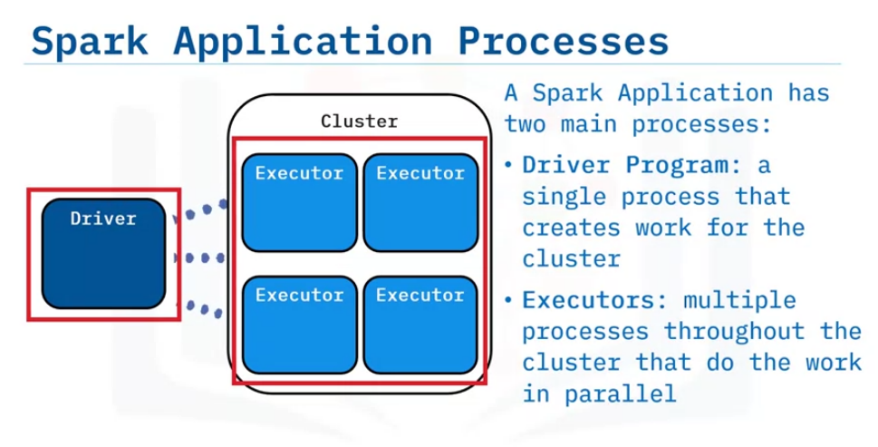
Apache Spark Architecture
Describe the architecture of Apache Spark,
identify processes in a Spark Application,
explain how Spark Jobs and Tasks are related,
define Stages and describe when a Data Shuffle occurs,
describe the cluster deploy modes the driver program can be run in.
A Spark application has two main processes.
The driver program runs as one process per application.
The driver process can be run on a cluster node or another machine as a client to the cluster.
The driver runs the application’s user code, creates work and sends it to the cluster.
An executor is a process running multiple threads to perform work concurrently for the cluster.
Executors work independently. There can be many throughout a cluster and one or more per node, depending on configuration.
Driver: Employer
Executor : Employee

Slide 3
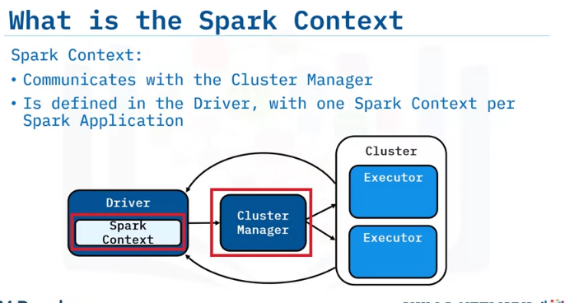
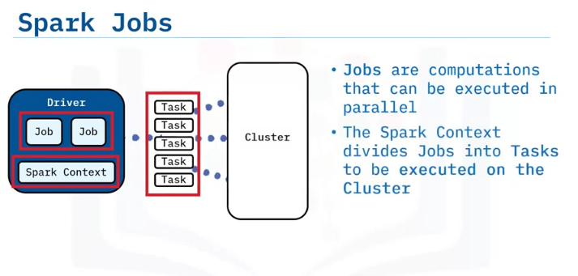
The Spark Context starts when the application launches and must be created in the driver before DataFrames or RDDs.
Any DataFrames or RDDs created under the context are tied to it and the context must remain active for the life of them.
The driver program creates work from the user code called “Jobs” (or computations that can be performed in parallel).
The Spark Context in the driver divides the jobs into tasks to be executed on the cluster

Slide 4
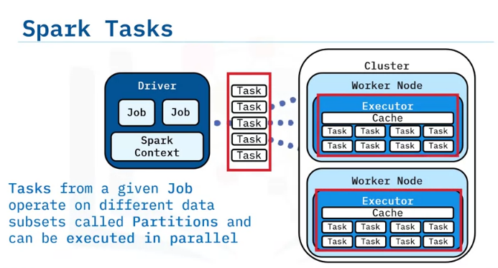
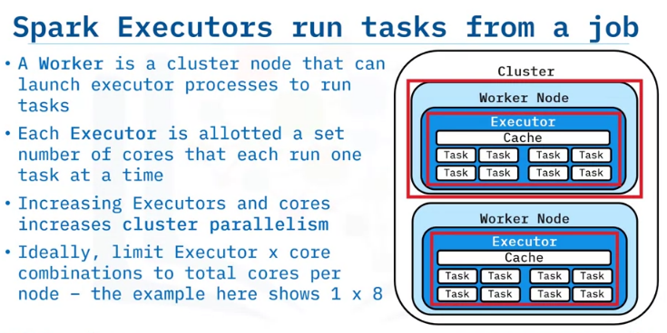
Tasks from a given job operate on different data subsets, called Partitions.
This means tasks can run in parallel in the Executors.
A Spark Worker is a cluster node that performs work.
A Spark Executor utilizes a set portion of local resources as memory and compute cores, running one task per available core.
Each executor manages its data caching as dictated by the driver.
In general, increasing executors and available cores increases the cluster’s parallelism.
Tasks run in separate threads until all cores are used.
When a task finishes, the executor puts the results in a new RDD partition or transfers them back to the driver.
Ideally, limit utilized cores to total cores available per node. For instance, an 8-core node could have 1 executor process using 8 cores.

Slide 5
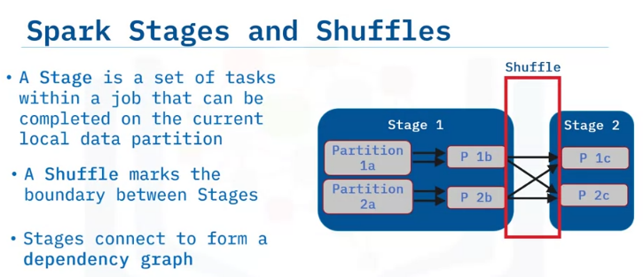
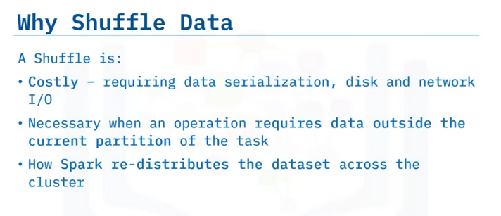
A “stage” in a Spark job represents a set of tasks an executor can complete on the current data partition.
When a task requires other data partitions, Spark must perform a “shuffle."
A shuffle marks the boundary between stages.
Subsequent tasks in later stages must wait for that stage to be completed before beginning execution, creating a dependency from one stage to the next.
Shuffles are costly as they require data serialization, disk and network I/O.
This is because they enable tasks to “pass over” other dataset partitions outside the current partition.
An example would be a “groupby” with a given key that requires scanning each partition to find matching records.
When Spark performs a shuffle, it redistributes the dataset across the cluster.

Slide 6
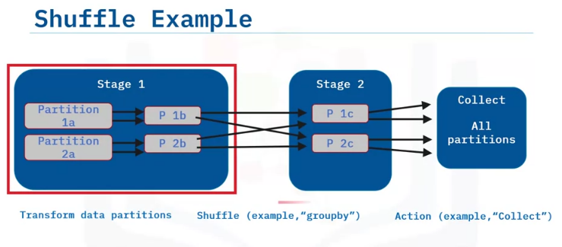
This example shows two stages separated by a shuffle.
In Stage 1, a transformation (such as a map) is applied on dataset “a” which has 2 partitions (“1a” and “2b”). This creates data set “b”.
The next operation requires a shuffle (such as a “groupby”).
Key values could exist in any other partition, so to group keys of equal value together, tasks must scan each partition to pick out the matching records.
Transformation results are placed in Stage 2. Here results have the same number of partitions, but this depends on the operation.
Final results are sent to the driver program as an action, such as collect.
NOTE: It is not advised to perform a collection to the driver on a large data set as it could easily use up the driver process memory. If the data set is large, apply a reduction before collection.

Slide 7
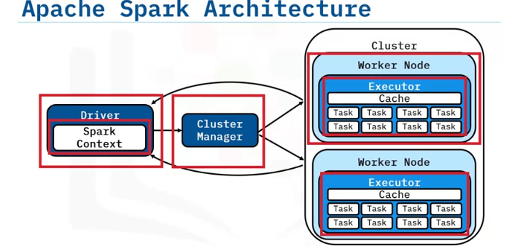
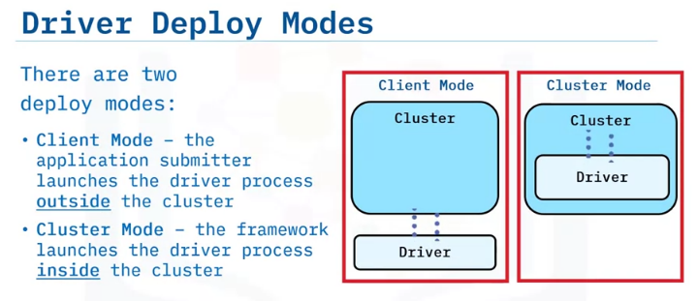
Let’s recap what we’ve learned about Spark Architecture.
It consists of the driver and the executor processes.
The cluster comprises the Cluster Manager and worker nodes.
The Spark Context schedules tasks to the cluster and the Cluster Manager manages the cluster’s resources.
The driver program can be run in either client or cluster mode.
In client mode the application submitter (such as a user machine terminal) launches the driver outside the cluster.
In cluster mode, the driver program is sent to and run on an available Worker node inside the cluster.
The driver must be able to communicate with the cluster while it is running, whether it is in client or cluster mode.

Slide 8
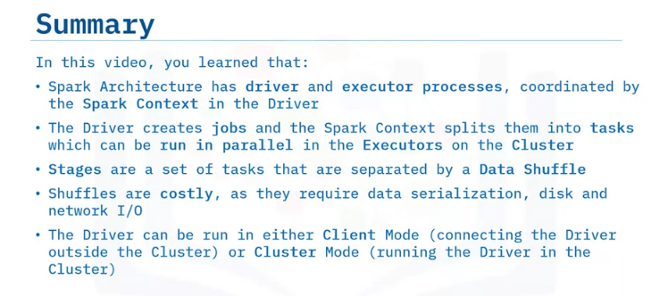

Slide 9
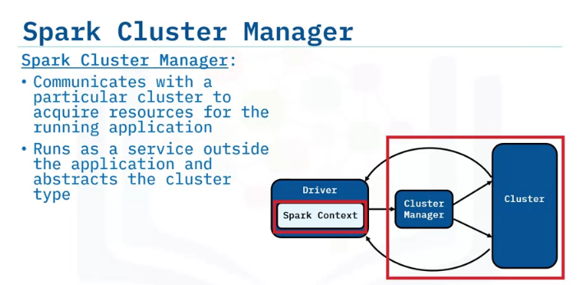
Identify the different modes of running Apache Spark on a cluster.
Describe the components and benefits of each cluster mode.
Describe how to run Spark to connect with each cluster mode
Describe how and when to setup a local Spark instance.
Overview of Apache Spark Cluster Modes
The Spark Cluster Manager communicates with a cluster to acquire resources for an application to run.
It runs as a service outside the application and abstracts the cluster type.
While an application is running, the Spark Context creates tasks and communicates to the cluster manager what resources are needed.
Then the cluster manager reserves executor cores and memory resources.
Once the resources are reserved, tasks can be transferred to the executor processes to run.

Slide 10
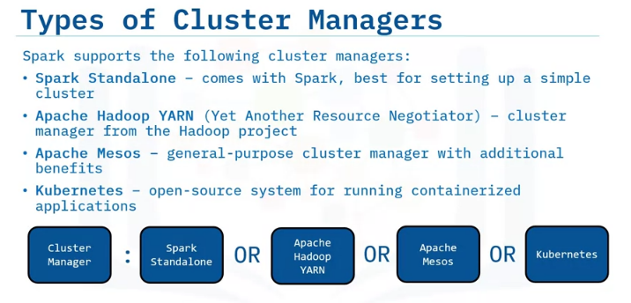
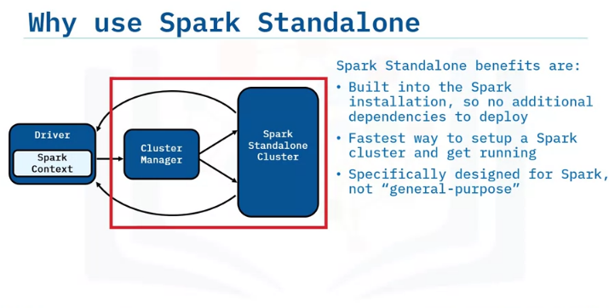
Spark has built-in support for several cluster managers.
A Standalone cluster manager is included with the Spark installation.
It’s best for setting up a simple cluster.
Apache Hadoop YARN, or Yet Another Resource Negotiator, is a cluster manager from the Hadoop project.
Apache Mesos is a general-purpose cluster manager that Spark can run with additional benefits.
Finally, Kubernetes is an open-source system for running containerized applications.
Spark Standalone comes packaged with the Spark installation, so there are no additional dependencies required to configure and deploy.
Spark Standalone is specifically designed to run Spark and is often the fastest way to get a cluster up and running applications.

Slide 11
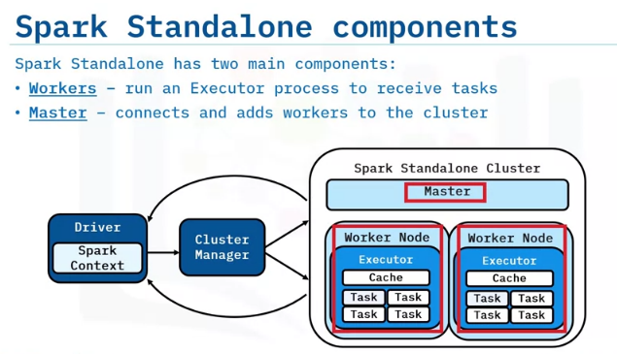
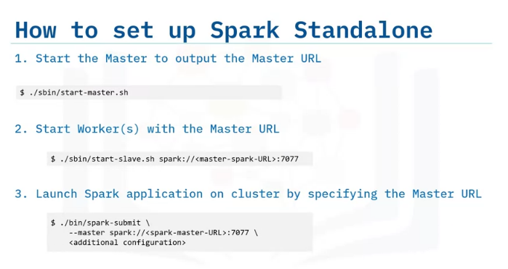
A Spark Standalone cluster has two main components: Workers and the Master.
The workers run on cluster nodes.
Workers start an executor process with one or more reserved cores.
There must be one master available which can run on any cluster node.
It connects workers to the cluster and keeps track of them with heartbeat polling.
However, if the master is together with a worker, do not reserve all the node’s cores and memory for the worker.
To manually set up a Spark Standalone cluster, start the Master.
The Master is assigned a URL with a hostname and port number.
After the master is up, you can use the Master URL to start workers on any node using bi-directional communication with the master.
Once the master and the workers are running, you can launch a Spark application on the cluster by specifying the master URL as an argument to connect them.
To see additional configuration options, refer to the Apache Spark documentation on the spark.apache.org website.

Slide 12
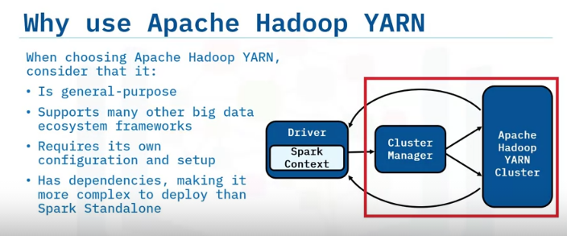
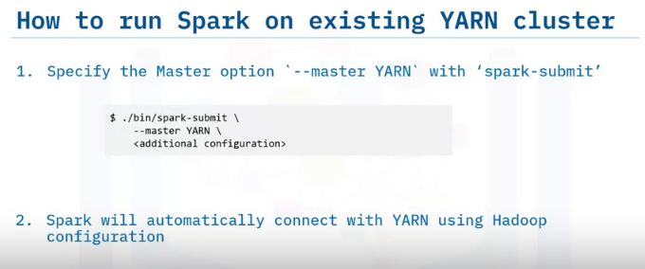
Apache Hadoop YARN is a general-purpose cluster manager.
It’s popular in the big data ecosystem and supports many other frameworks besides Spark.
YARN clusters have their own dependencies, set-up and configuration requirements so deploying them is more complex than Spark Standalone.
To run Spark on an existing YARN cluster, use the ‘--master’ option with the keyword YARN.
When Spark sees that the cluster manager type is YARN, it will look for the standard Hadoop configuration files to decide how to connect with the YARN cluster.
No other configuration from Spark is needed.

Slide 13
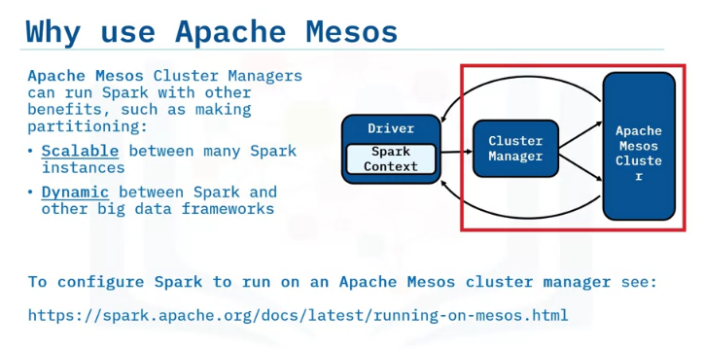
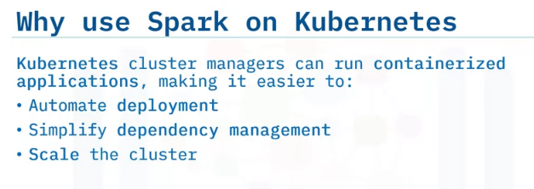
Apache Mesos is another general-purpose cluster manager supported by Spark.
Using Mesos has some advantages.
It can provide
dynamic partitioning between Spark and other big data frameworks &
scalable partitioning between multiple Spark instances.
However, running Spark on Apache Mesos might require some additional setup depending on your configuration requirements.
A Kubernetes cluster runs containerized applications.
This makes Spark applications more portable and helps automate deployment, simplify dependency management and scale the cluster as needed.
Spark uses a built-in native Kubernetes scheduler.

Slide 14
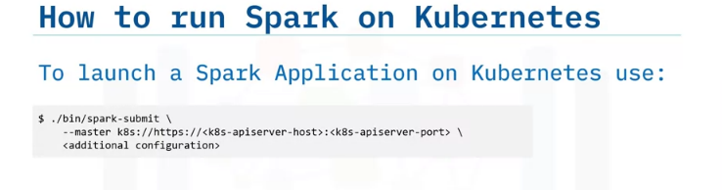
To run Spark on Kubernetes, use the example call shown.

Slide 15
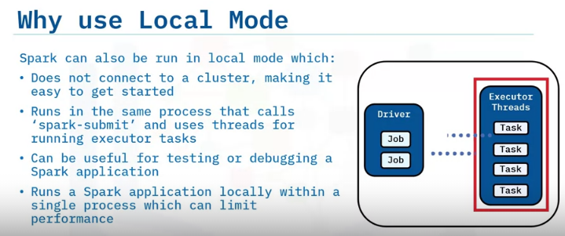
Local mode runs a Spark application as a single process locally on the machine.
Executors are run as separate threads in the main process that calls 'spark-submit’.
Local mode does not connect to any cluster or require configuration outside a basic Spark installation.
Local mode can be run on a laptop.
That’s useful for testing or debugging a Spark application, for example, testing a small data subset to verify correctness before running the application on a cluster.
However, being constrained by a single process means local mode is not designed for optimal performance.

Slide 16
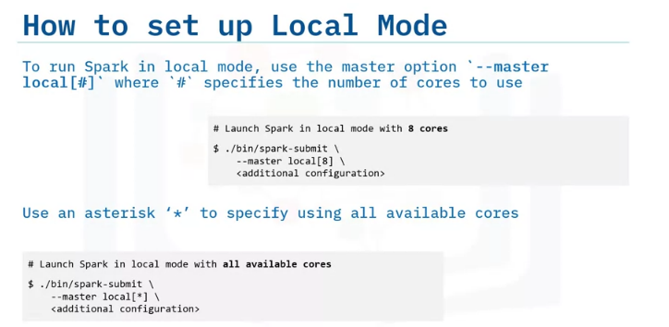
To run in local mode, use the ‘--master’ option with the keyword ‘local’ followed by a number to indicate how many cores the Spark application can use for the executor.
To use all available cores, replace the number with an asterisk wildcard.
Keep in mind not all configuration for a cluster will be valid in local mode.

Slide 17
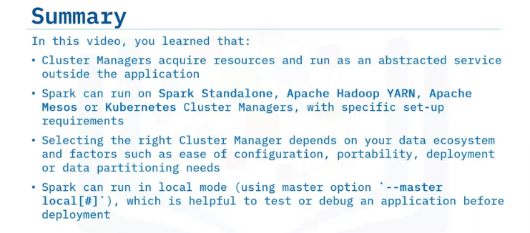

Slide 18
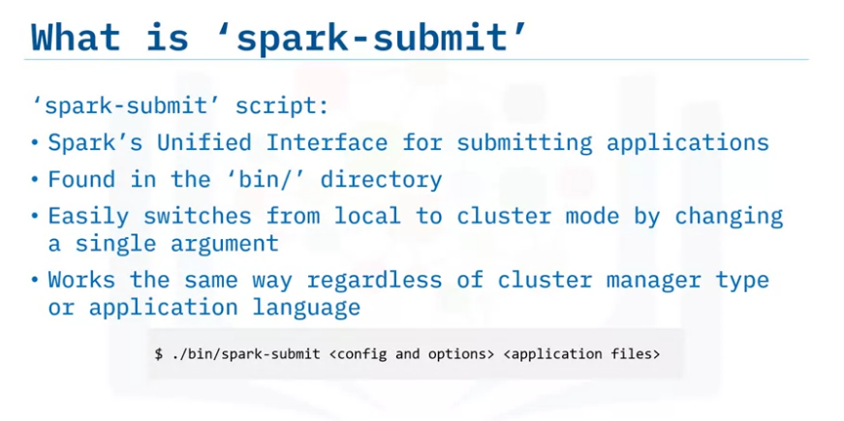
Describe how to submit an Apache Spark application,
explain the characteristics of Spark’s unified interface, ‘spark-submit,’
describe and apply the options you can use to submit applications,
describe ways of managing external application dependencies,
describe the benefits of using Spark Shell to run applications.
How to Run an Apache Spark Application
Spark comes with a unified interface for submitting applications – it is the ‘spark-submit’
script found in the ‘bin/’ directory.
‘spark-submit’ can be used for all supported cluster types and accepts many configuration options for the application or cluster.
“Unified interface” means you can switch from running Spark in local mode to cluster by changing a single argument.
‘spark-submit’ works the same way, no matter the application language.
For example, a cluster can run Python and Java applications simultaneously by passing in the required files

Slide 19
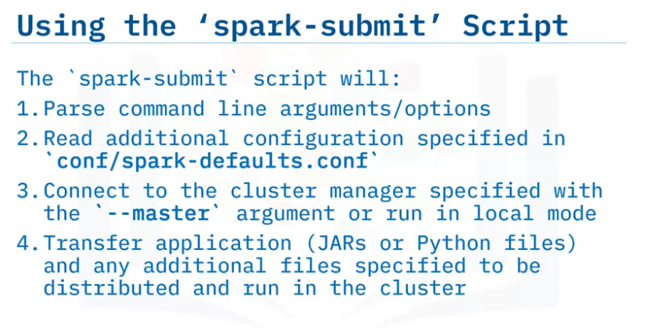
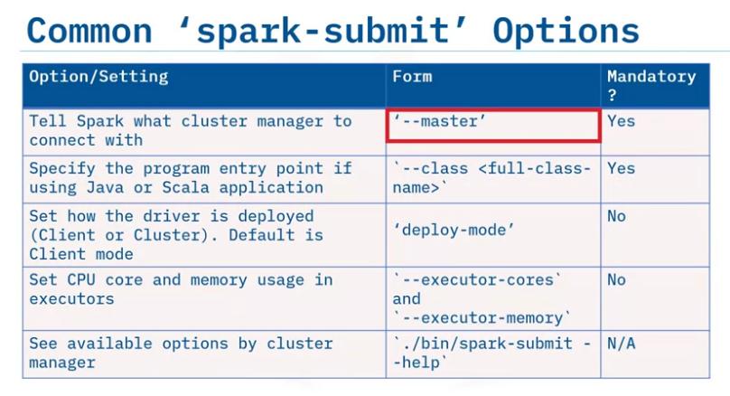
The ‘spark-submit’ script first parses any command line arguments or options.
Then it reads any additional configuration specified in the ‘spark-defaults’ folder.
Next, the ‘--master’ argument tells the application how to connect to the cluster or run locally.
Any application files (including JARs or Python files) must be specified so they can start the driver program and distribute files to run in the cluster.
Some ‘spark-submit’ options are mandatory, such as specifying the master option to tell Spark which cluster manager to connect to.
If the application is written in Java or Scala and packaged in a JAR, you must specify the full class name of the program entry point.
Other options include driver deploy mode (run as a client or in the cluster) and executor resource settings (such as reserving memory or cores).
Driver deploy mode defaults to client mode.
Some options relate to specific cluster managers.

Slide 20
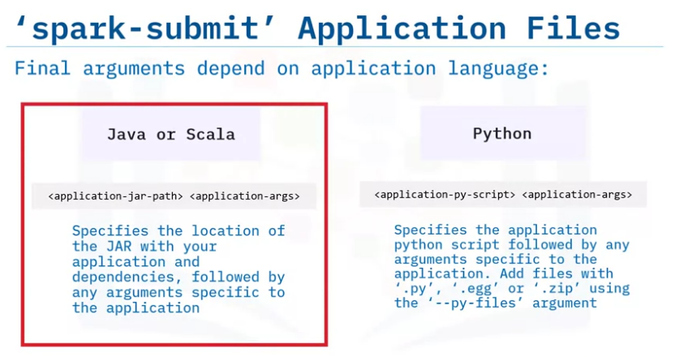
Additional Spark configuration can be specified on the command line using the ‘--conf’ argument followed by key=value.
For Java or Scala and Python, final arguments will be the path to the application JAR or Python script.
Next are optional application-specific arguments.
These will automatically be passed in.
You can add Python files with ‘.py,’ ‘.egg’, or ‘.zip’ using the ‘--py-files’ argument.
These files will be distributed to the cluster and available in the Python environment

Slide 21
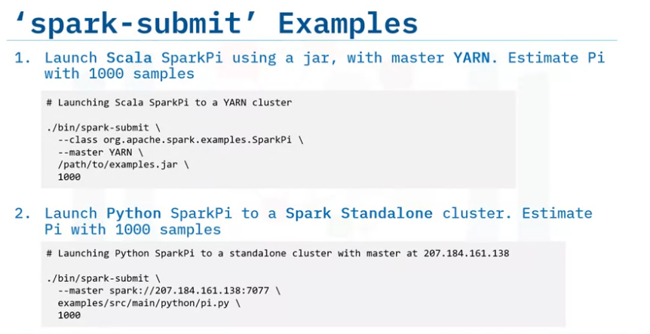
Let’s look at two ‘spark-submit’ examples.
The first launches SparkPi, written in Scala and packaged in a JAR.
YARN is the master.
The application uses an additional argument (how many samples to take in the cluster to compute Pi).
The second example launches a SparkPi Python version.
The master is a Spark Standalone cluster and we simply pass the path to the Python script

Slide 22
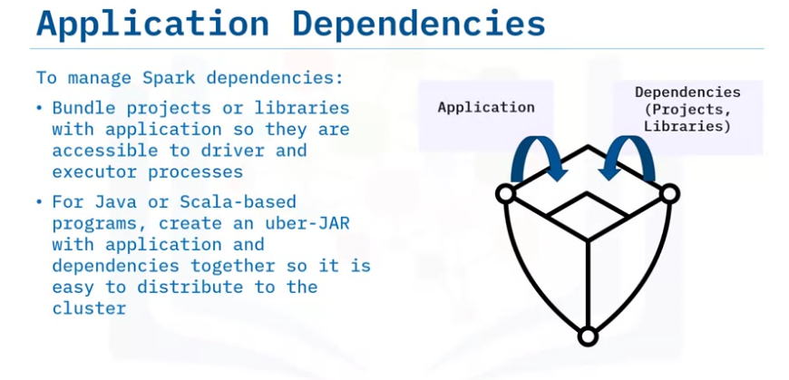
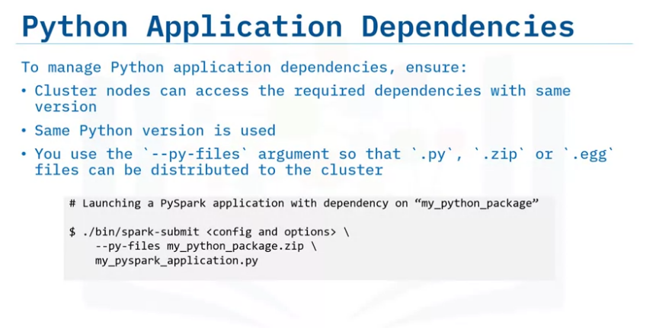
To manage Spark dependencies, the application project or library must be accessible for the driver and cluster executor processes.
For a Java or Scala-based application, it’s best to create an uber-JAR.
This is a single JAR file with all dependencies (including transitive ones) so the application is portable throughout the cluster
For Python applications, ensure that:
(1) the cluster nodes access required dependencies with the same version &
(2) the same Python version is used.
Solutions for Python dependencies may involve creating virtual environments so that applications can run in separate, isolated environments.
Python dependencies can be included in the spark-submit script using the ‘--py-files’ argument: this will accept ‘.py’, ‘.zip’ or ‘.egg’ files.

Slide 23
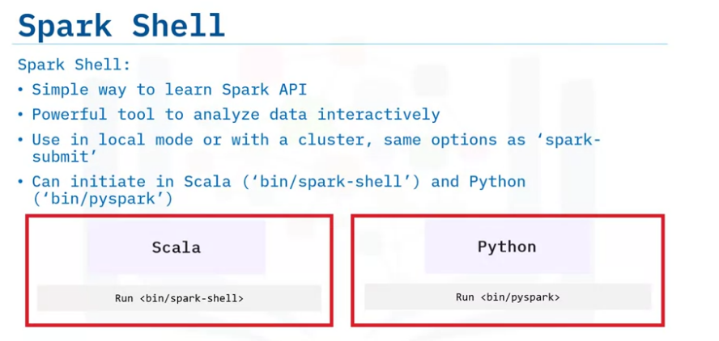
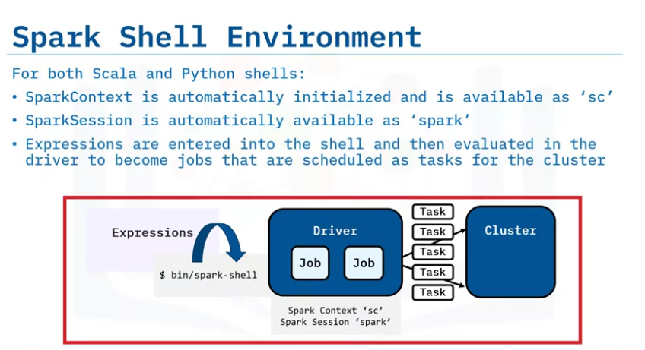
Spark Shell is available for Scala and Python, giving you access to Spark APIs for working with data as Spark jobs.
Spark Shell can be used in local or cluster mode, with all options available.
When Spark Shell starts, the environment automatically initializes the SparkContext and SparkSession variables.
This means you can start working with data immediately.
Expressions are entered in the shell and evaluated in the driver.
Entering an action on a shell DataFrame generates Spark jobs that are sent to the cluster to be scheduled as tasks.

Slide 24
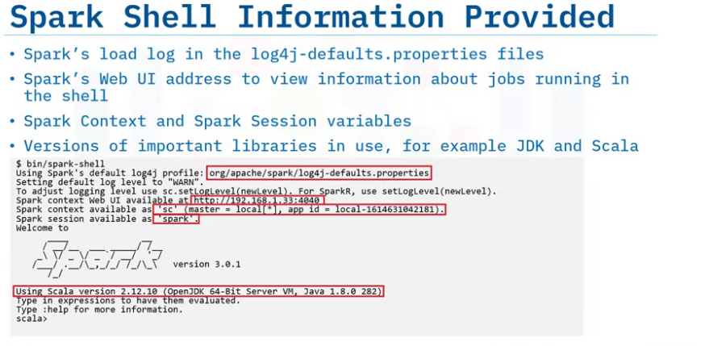
This example shows the Spark Scala shell starting up in local mode.
The print-out includes: Spark’s load log in the log4j-defaults.
properties file; Spark’s Web UI address, displaying running jobs in the shell;
Variable names for the initialized SparkContext and SparkSession, and Version information for important libraries like JDK and Scala.

Slide 25
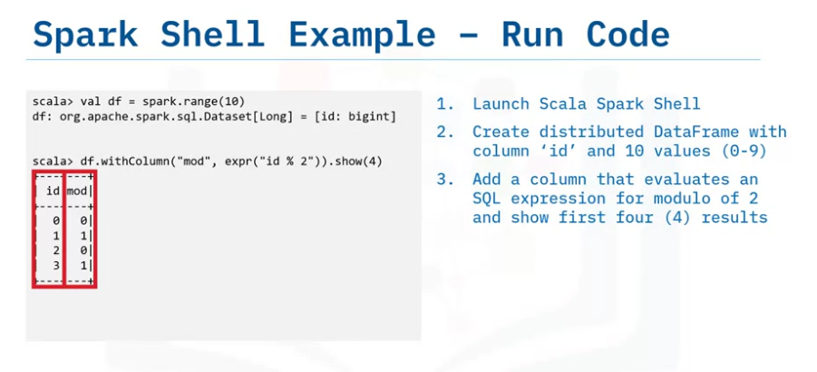
This example shows running code in the Scala shell.
In the first line, a DataFrame is created as a distributed range of integers from 0 to 9.
The second line transforms the DataFrame, adding a column calculating the modulo of 2.
Next is an action that prints out the first four records of the resulting DataFrame.

Slide 26
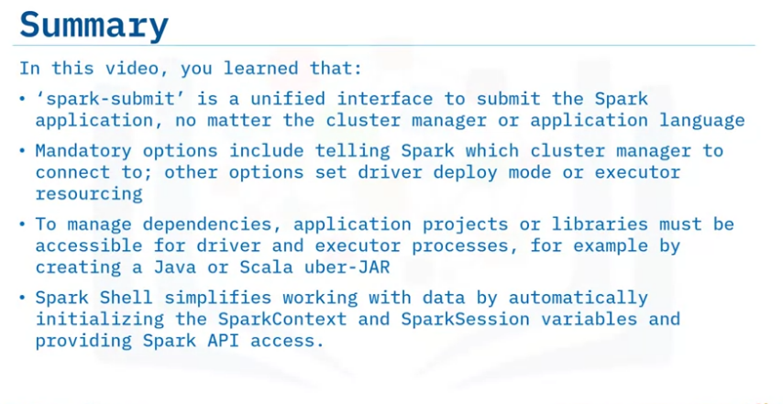

Slide 27
Summary & Highlights
In this lesson, you learned that:
Spark Architecture has driver and executor processes, coordinated by the Spark Context in the Driver.
The Driver creates jobs and the Spark Context splits jobs into tasks which can be run in parallel in the executors on the cluster. Stages are a set of tasks that are separated by a data shuffle. Shuffles are costly, as they require data serialization, disk and network I/O. The driver program can be run in either client Mode (connecting the driver outside the cluster) or cluster mode (running the driver in the cluster).
Cluster managers acquire resources and run as an abstracted service outside the application. Spark can run on Spark Standalone, Apache Hadoop YARN, Apache Mesos or Kubernetes cluster managers, with specific set-up requirements. Choosing a cluster manager depends on your data ecosystem and factors such as ease of configuration, portability, deployment, or data partitioning needs. Spark can also run using local mode, which is useful for testing or debugging an application.
'spark-submit’ is a unified interface to submit the Spark application, no matter the cluster manager or application language. Mandatory options include telling Spark which cluster manager to connect to; other options set driver deploy mode or executor resourcing. To manage dependencies, application projects or libraries must be accessible for driver and executor processes, for example by creating a Java or Scala uber-JAR. Spark Shell simplifies working with data by automatically initializing the SparkContext and SparkSession variables and providing Spark API access.

Slide 28
PART 2 : SPARK RUNTIME ENVIRONMENTS

Slide 29
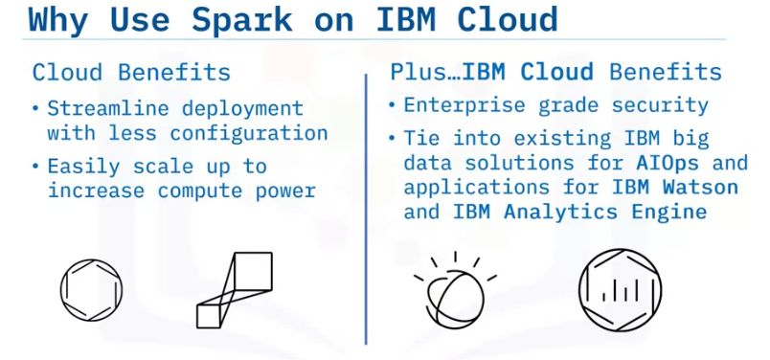
List the benefits of using Apache Spark on IBM Cloud,
define AIOps and describe how Spark can be used within AIOps,
describe how to use Spark with IBM Spectrum Conductor, IBM Watson and the IBM Analytics Engine
Using Apache Spark on IBM Cloud
You can run Spark on a local cluster or a cloud.
However, it may be difficult to configure nodes in a local cluster so that they are visible and communicate properly.
Running Spark on a cloud streamlines deployment by using pre-existing default configuration.
This makes it easy to scale up the cluster to add nodes and increase compute power as needed.
Different cloud providers support running Spark on a variety of cluster managers.
Running Spark on an IBM cloud brings added benefits.
It provides enterprise grade security.
You can also tie into existing IBM big data solutions for AIOps and applications for IBM Watson and the IBM Analytics Engine

Slide 30
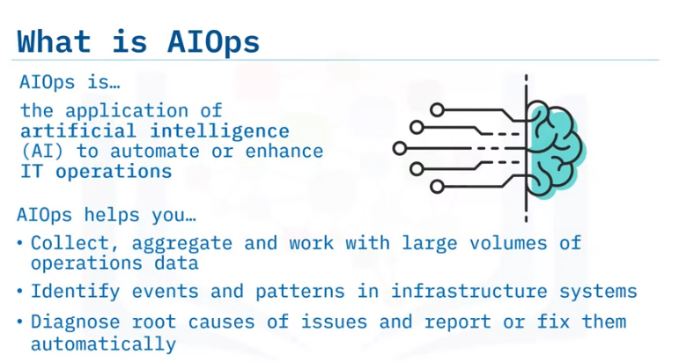
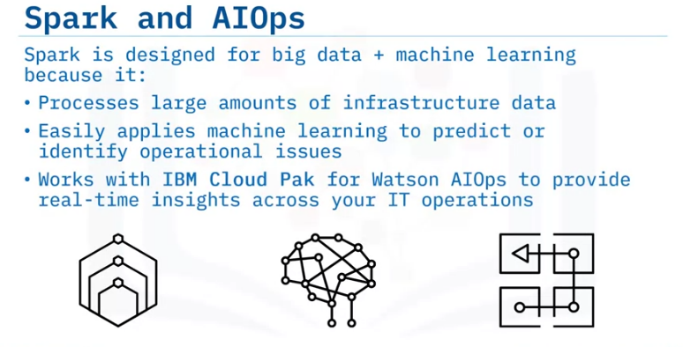
“AIOps” means applying artificial intelligence to automate or enhance IT operations.
AIOps helps you: Collect, aggregate and work with large volumes of operations data, identify events and patterns in large or complex infrastructure systems, quickly diagnose the root causes of issues so you can report or fix them automatically.
Spark is particularly well-suited for big data analytics.
It is ideal for processing large volumes of infrastructure data and applying machine learning to predict or identify operational issues.
IBM Cloud Pak for Watson AIOps offers solutions with Spark that can correlate data across your operations toolchain to bring insights or identify issues in real-time.
Examples could include data insights about tool availability, performance, or outages.

Slide 31
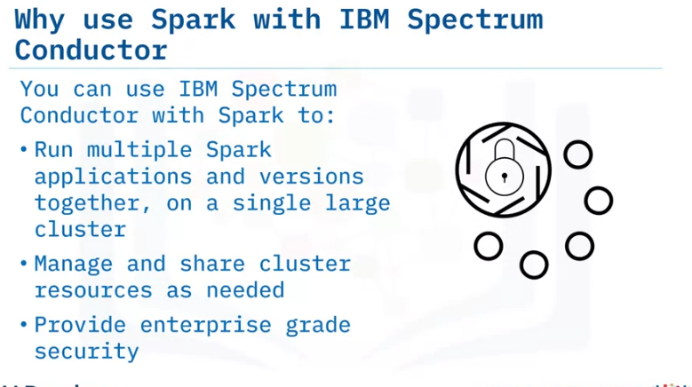
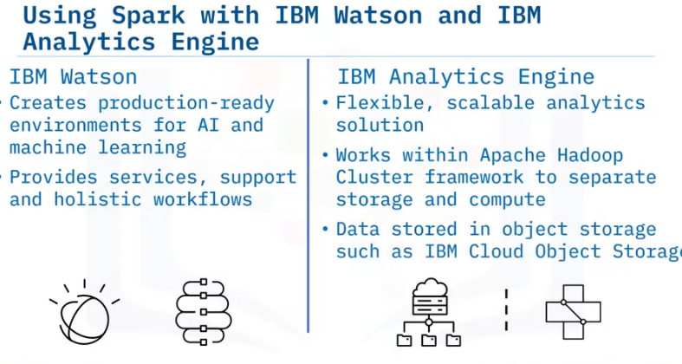
IBM Spectrum Conductor is a multi-tenant platform for deploying and managing Spark and other frameworks on a cluster with shared resources.
This enables multiple Spark applications and versions to be run together, on a single large cluster.
Cluster resources can be divided up dynamically, avoiding downtime.
IBM Spectrum Conductor also provides Spark with enterprise grade security.
IBM Watson helps create production-ready environments for AI and machine learning by providing services, support and holistic workflows.
Reducing setup and maintenance saves time so you can concentrate on training Spark to enhance its machine learning capabilities.
IBM Analytics Engine works with Spark to provide a flexible, scalable analytics solution.
It uses an Apache Hadoop cluster framework to separate storage and compute by storing data in object storage such as IBM Cloud Object Storage.
This means you only need to run compute nodes when needed.

Slide 32
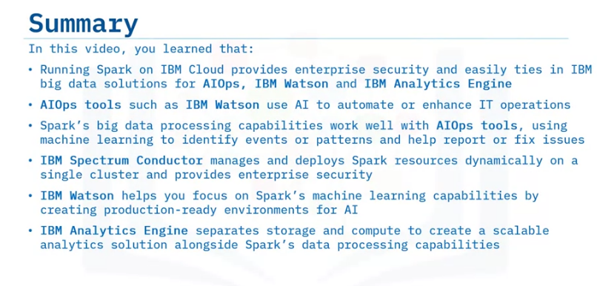

Slide 33
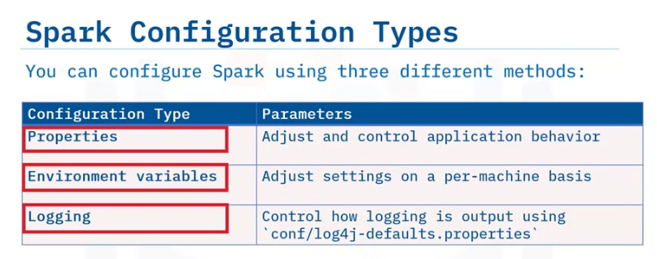
Describe the configuration types of an Apache Spark Application,
explain the purpose and common options for each configuration type,
describe when to use static or dynamic configuration.
Setting Apache Spark Configuration
You can configure a Spark Application using three different methods:
properties, environment variables, or logging configuration.
You can set Spark properties to adjust and control most application behaviors, including setting properties with the driver and sharing them with the cluster.
Environment variables are loaded on each machine, so they can be adjusted on a per-machine basis if hardware or installed software differs between the cluster nodes.
Spark logging is controlled by the log4j defaults file, which dictates what level of messages, such as info or errors, are logged to file or output to the driver during application execution.

Slide 34
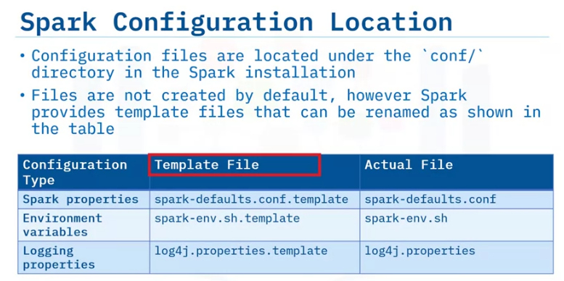
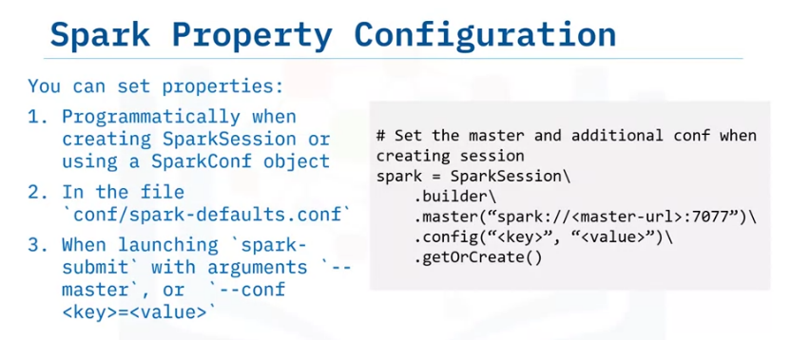
Spark configuration files are located under the “conf” directory in the installation.
By default, there are no pre-existing files after installation, however Spark provides a template for each configuration type with the filenames shown here.
You can create the appropriate file by removing the ‘.template’ extension.
Inside the template files, are sample configurations for common settings.
You can enable them by uncommenting.
You can configure Spark properties in a few different ways.
In the driver program, you can set the configuration programmatically when creating the SparkSession or by using a separate SparkConf object that is then passed into the session constructor.
Properties can be set in a configuration file found at ‘conf/spark-defaults.conf’
Properties can also be set when launching the application with spark-submit, either by using provided options such as ‘--master’ or using the “--conf” option with a key, value pair.

Slide 35
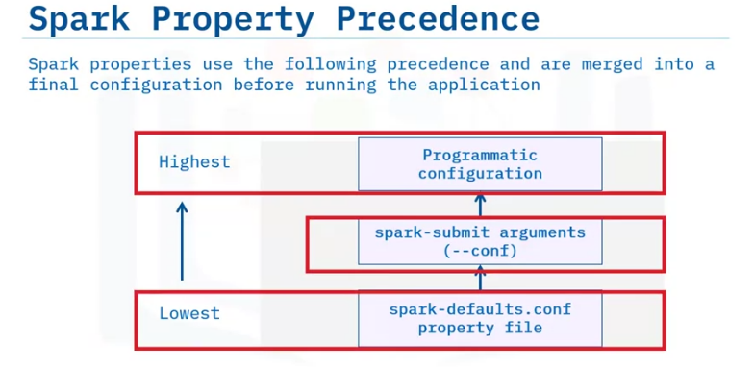
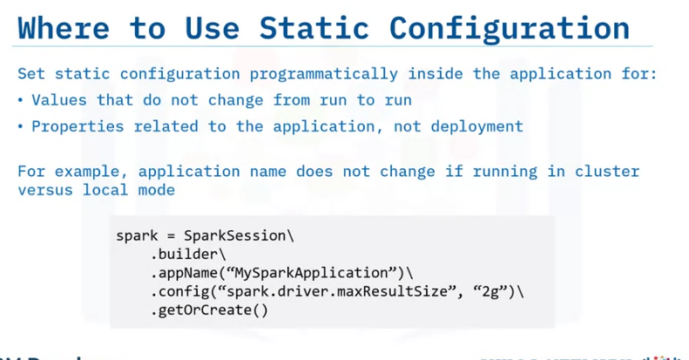
Because Spark properties can be set in different ways, let’s look at how they are merged to build the final configuration for the application.
The configuration set programmatically takes the highest precedence.
This means that if a configuration has already been set elsewhere or programmed into the application it will be overwritten.
Next is the configuration provided with the spark-submit script.
Last is any configuration set in the spark-defaults.conf file.
Static configuration refers to settings that are written programmatically into the application itself.
These settings are not usually changed because it requires modifying the application itself.
Use static configuration for something that is unlikely to be changed or tweaked between application runs, such as application name or other properties related to the application only.
For example, you would not use static configuration when it depends on what type of cluster or resource requirements are available.
The example here sets the application name property and there is an additional configuration to set the maximum result size in the driver to 2 gigabytes.

Slide 36
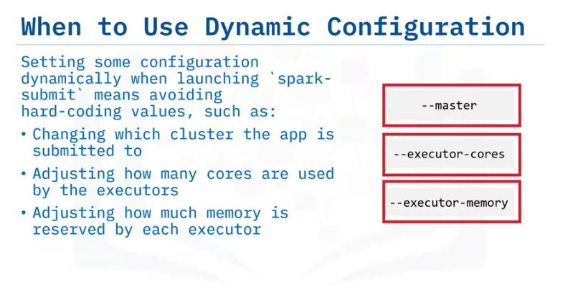
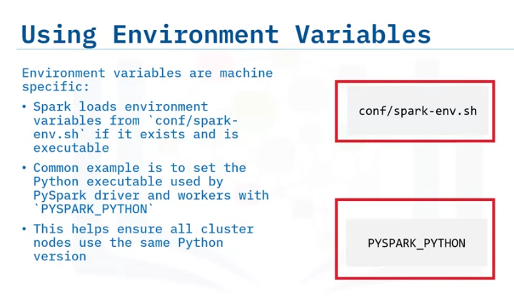
Spark dynamic configuration is useful to avoid hardcoding specific values in the application itself.
This is usually done for configuration such as the master location, so that the application can be launched on a cluster by simply changing the master location.
Other examples include setting dynamically how many cores are used or how much memory is reserved by each executor so that they can be properly tuned for whatever cluster the application is run on.
These are loaded from each machine in the cluster when a Spark process is started.
Since these can be loaded differently for each machine, it can help configure specifics on a per-machine basis.
A common usage is to ensure each machine in the cluster uses the same Python executable by setting the “PYSPARK_PYTHON” environment variable.

Slide 37
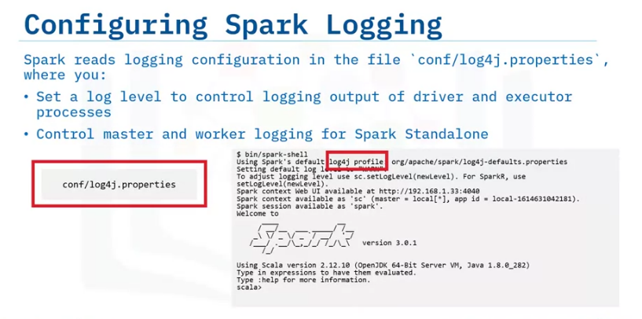
Spark logging is controlled using log4j and the configuration is read through ‘conf/log4j-properties’.
Here you can adjust a log level to determine which messages (such as debug, info or errors) are shown in the Spark logs.
Log4j allows the configuration to set where the logs are sent to and adjust specific components of Spark or third-party libraries.

Slide 38


Slide 39

Running Spark on Kubernetes
Describe when and why Kubernetes is used,
describe how to run Kubernetes locally versus hosted on the cloud,
explain how to run Apache Spark on Kubernetes.
Kubernetes (also abbreviated as “k8s”), is a popular framework for running containerized applications on a cluster.
It’s an open-source system that is highly scalable and provides flexible deployments to the cluster.
Kubernetes is portable, so it can be run in the same way whether you are running it in the cloud or on-premises.

Slide 40

Kubernetes is used to manage containers that run distributed systems, such as Spark, in a more flexible and resilient way.
It provides flexibility in the way cluster resources are used and is more resilient if an application errors out or nodes fail.
Kubernetes has many benefits, including:
Network service discovery and
cluster load balancing, Automating scale up and down of systems on the cluster,
making the cluster easier to manage with maximum up-time Orchestrating storage to make better use of what is available.
(જે ઉપલબ્ધ છે તેનો બહેતર ઉપયોગ કરવા માટે સ્ટોરેજનું આયોજન કરવું.)

Slide 41


While Kubernetes is designed to work on a cluster, it also supports being hosted locally, on a single machine.
You can try out a locally-hosted Kubernetes cluster, setting it up using tools such as minikube.
This is commonly used as a development environment, enabling you to apply changes locally first and test before putting them into production on a cluster in the cloud.
Containerization means that applications run the same way locally as they would on the cluster – hence you can identify and resolve any issues more quickly and easily.
Running a Kubernetes cluster on a cloud is a good choice for production environments because of the ease of deployment and flexibility it provides.
There are two ways to get started with Kubernetes on the cloud.
You can use existing tools to bootstrap the cluster and get the necessary components in place.
Alternatively, use a certified Kubernetes provider with a turnkey option to accelerate getting a Kubernetes cluster up.

Slide 42


Spark version 2.3 and above can be run on top of Kubernetes as an alternative deployment mode when submitting a Spark application.
Using Spark on Kubernetes comes with some very useful benefits.:
Containerization means Spark applications are more portable.
It makes it easier to manage dependencies and setup the required environment throughout the cluster.
Containerization supports better resource sharing.
Multiple Spark applications running concurrently can easily share the available resources and run in isolation of each other.
To submit a Spark application to a Kubernetes cluster, set the ‘--master’ option to the URL for the Kubernetes API server and port.
Spark creates a driver which in turn creates executors, with both driver and executors running inside Kubernetes pods.
A ‘pod’ is a tightly coupled group of containers with shared resources.
The application can be deployed as client or cluster mode.
However, for client mode some additional considerations are needed.
The executors must be able to communicate and connect with the driver program.
Use the driver’s pod name to set ‘spark.kubernetes.driver.pod.name’.
This will ensure the executor pods are cleaned up along with the driver pod when the application finishes.

Slide 43


Slide 44
Summary & Highlights
In this lesson you learned that:
Running Spark on IBM Cloud provides enterprise security and easily ties in IBM big data solutions for AIOps, IBM Watson and IBM Analytics Engine. Spark’s big data processing capabilities work well with AIOps tools, using machine learning to identify events or patterns and help report or fix issues. IBM Spectrum Conductor manages and deploys Spark resources dynamically on a single cluster and provides enterprise security. IBM Watson helps you focus on Spark’s machine learning capabilities by creating automated production-ready environments for AI. IBM Analytics Engine separates storage and compute to create a scalable analytics solution alongside Spark’s data processing capabilities.
You can set Spark configuration using properties (to control application behavior), environment variables (to adjust settings on a per-machine basis) or logging properties (to control logging outputs). Spark property configuration follows a precedence order, with the highest being configuration set programmatically, then spark-submit configuration and lastly configuration set in the spark-defaults.conf file. Use Static configuration options for values that don’t change from run to run or properties related to the application, such as the application name. Use Dynamic configuration options for values that change or need tuning when deployed, such as master location, executor memory or core settings.
Use Kubernetes to run containerized applications on a cluster, to manage distributed systems such as Spark with more flexibility and resilience. You can run Kubernetes as a deployment environment, which is useful for trying out changes before deploying to clusters in the cloud. Kubernetes can be hosted on private or hybrid clouds, and set up using existing tools to bootstrap clusters, or using turnkey options from certified providers. While you can use Kubernetes with Spark launched either in client or cluster mode, when using Client mode, executors must be able to connect with the driver and pod cleanup settings are required

